Slide 1
Automated Thin Section Analysis
ACSE MSc Independent Research Project
Richard Boyne (CID 01057503)
Imperial College London Department of Earth Science and Engineering
10th September 2019

Slide 2

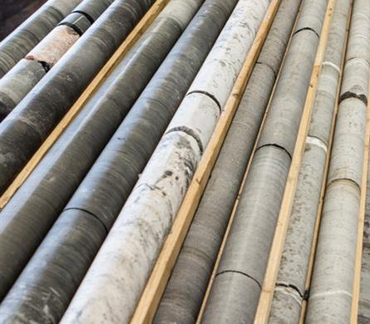
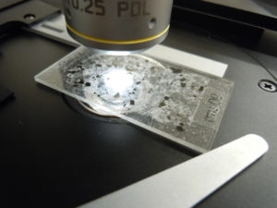
Automated Thin Section Analysis
Agenda
Thin Section Images
Project Aims
TSA Software
Overview
Algorithms
Implementation
Results
Conclusions
Questions

Slide 3
Thin Section Images
Texas Sandstone (300x magnification)
Core slices under microscope
Cross polariser angles give additional insight
Analysis determines properties (e.g. porosity, grain size distribution)
High regional variability
Cheap to produce, expensive to analyse
Various analysis methods:
Point counting
Image filters & thresholds
Watershed transformation
Machine learning techniques (in development)
Parallel Polarisers
Cross Polarisers

Slide 4
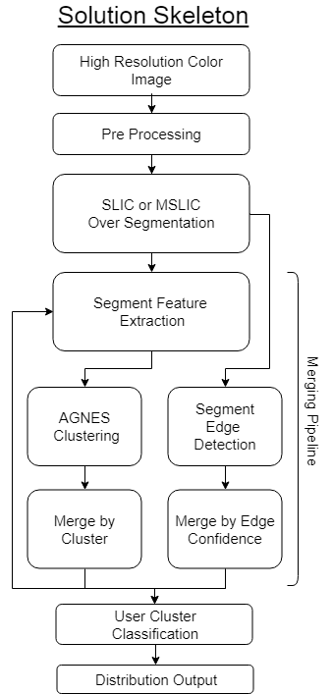
Project Aims
Develop a python toolset for fast Thin Section Analysis (TSA)
Software should be:
Adaptable to develop a range of pipelines
Sustainable for future development within Wintershall DEA
Usable with little programming training
Valid for thin section images
Optimisation of features and hyperparameters not considered
TS images cropped for easier development

Slide 5
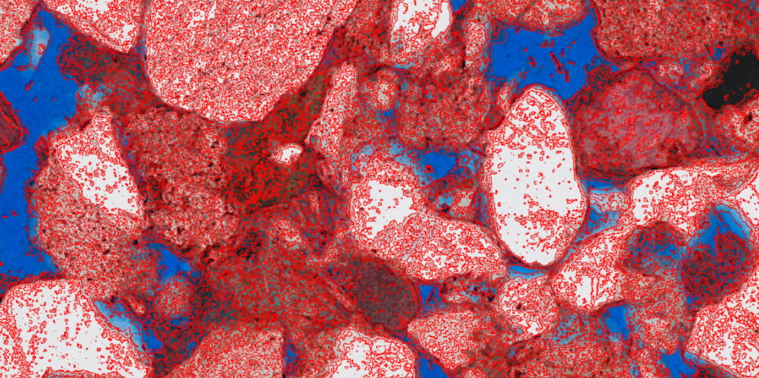
Additional: Need for Locality
Example of no locality enforcement on Texas sandstone sample
Contour like behavior seen across the entire image

Slide 6
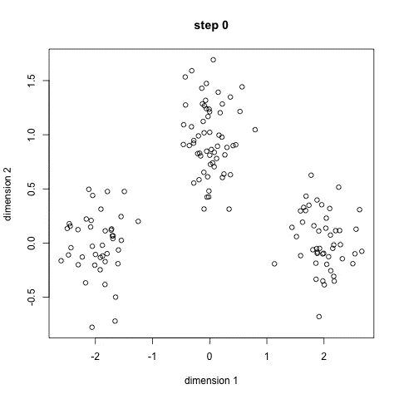
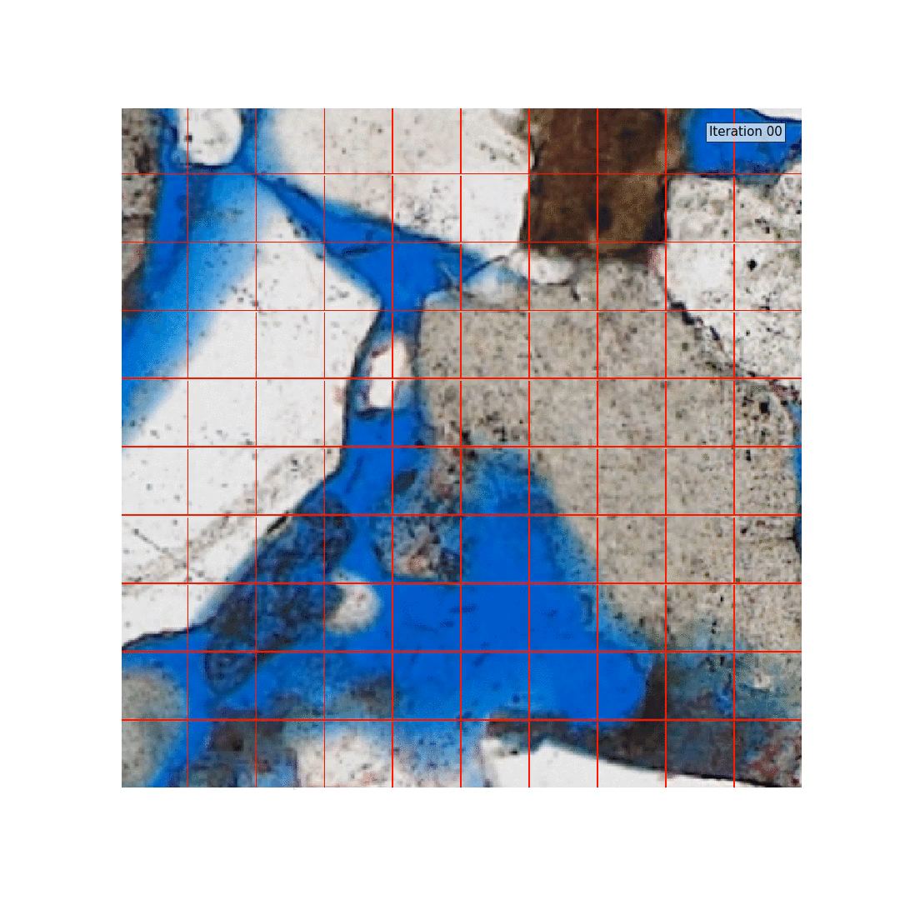
K-means
SLIC

Slide 7
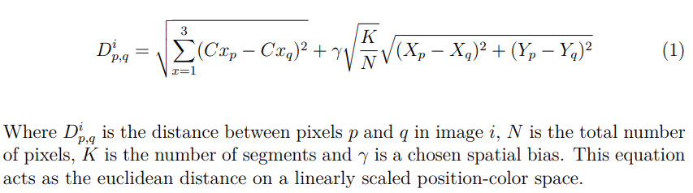
Additional: Color-Position Scaling

Slide 8
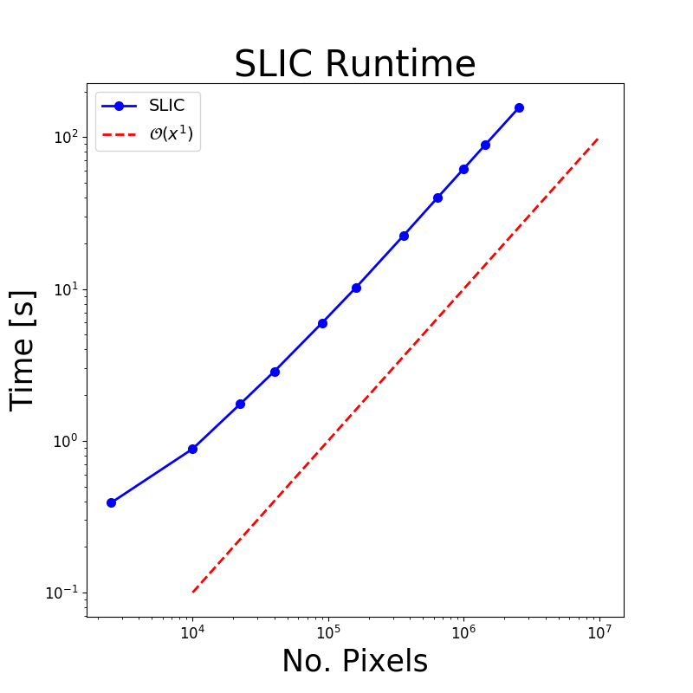
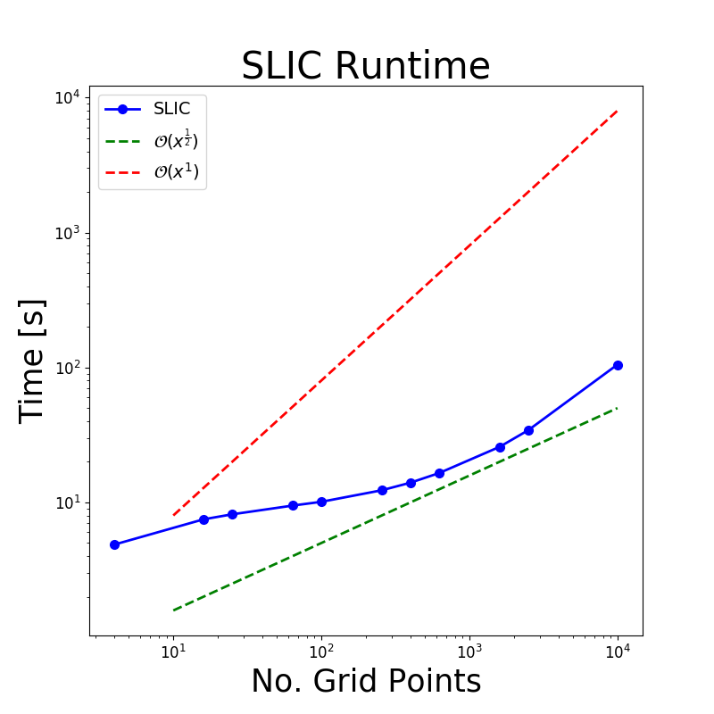
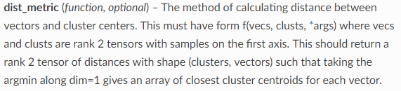
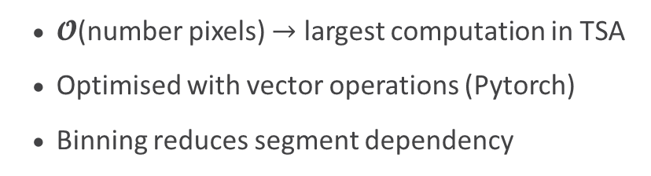
Performance
Image Size
Number of Segments
$𝓞$(number pixels) $→$ largest computation in TSA
Optimised with vector operations (Pytorch)
Binning reduces segment dependency
Changeable distance metric:

Slide 9
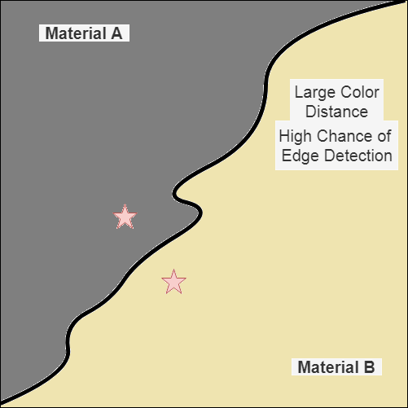
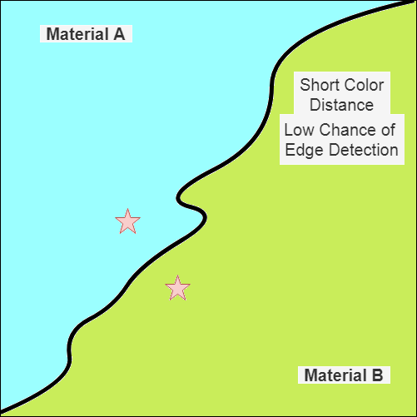
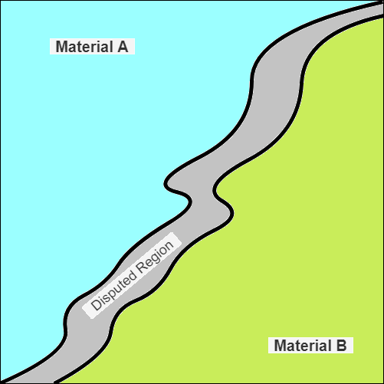
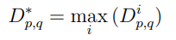
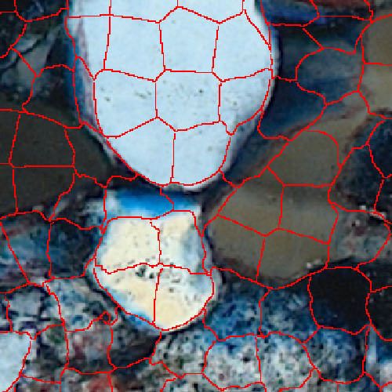
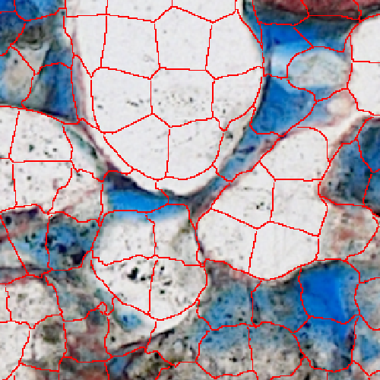
MSLIC
Crossed Image
Parallel Image
Overlap
Combine multiple images in single segmentation
Changeable combination metric
Better segmentation in theory
Image misalignment means worse in practice
Allows for feature extraction from all images
MSLIC creating common mask between images

Slide 10
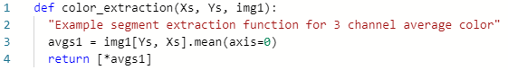
Segment Clustering
Unsupervised clustering of segments with common material
Used to merge over-segmented regions
Versatile to varying images
Feature extraction defined by user:
Allows for variable feature selection
Allows for external clustering algorithms

Slide 11
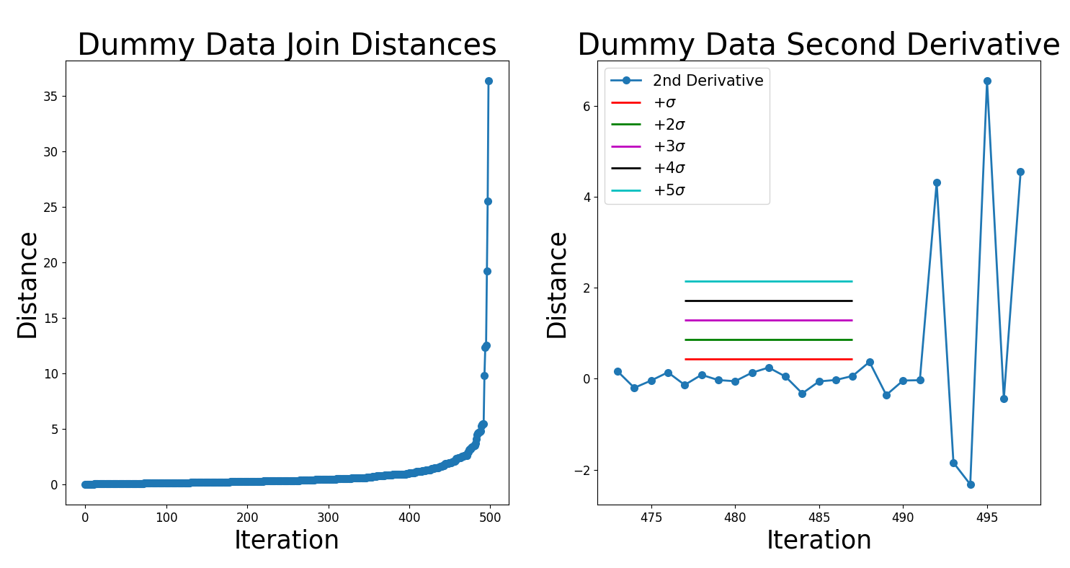
Additional: AGNES Distances
7 Clusters
Merging criteria example for AGNES clustering using dummy data 7 clusters (seen before)

Slide 12
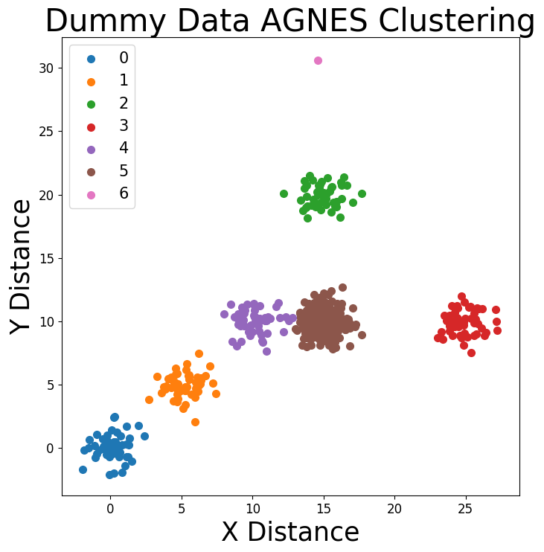
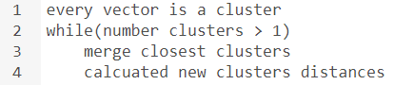
AGNES
One of many possible algorithms
Agglomerative clustering (bottom up)
Determines number of clusters
Multiple termination criteria and distance metrics implemented
Example AGNES clustering on 2D dummy data

Slide 13
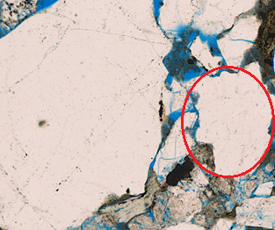
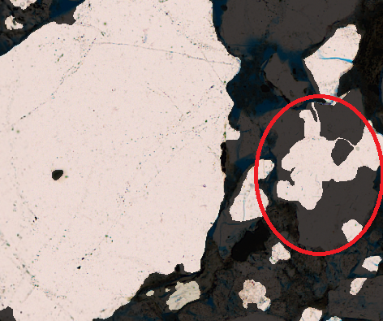
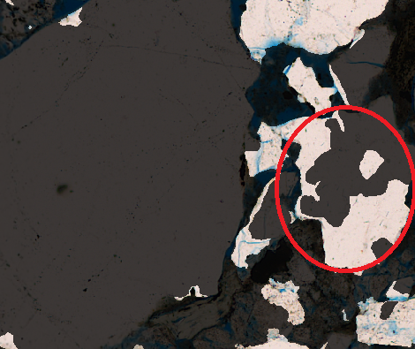

Original Image
Clustering Difficulties
Distance clustering $→$ feature scaling required
Difficulties combining texture and colour
Either individually insufficient
Grain segments clustered separately due to:
Texture variations
Natural colour variation
Differences between images
Example Cluster 1
Example Cluster 2
Colour clustering only valid for coarse labelling
(i.e. rock, pore, clay)

Slide 14
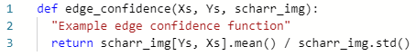
Edge Confidence
Attempt to identify which edges are due to over-segmenting
Independent from clustering
Theoretically better for isolating grains
User defined edge confidence:

Slide 15
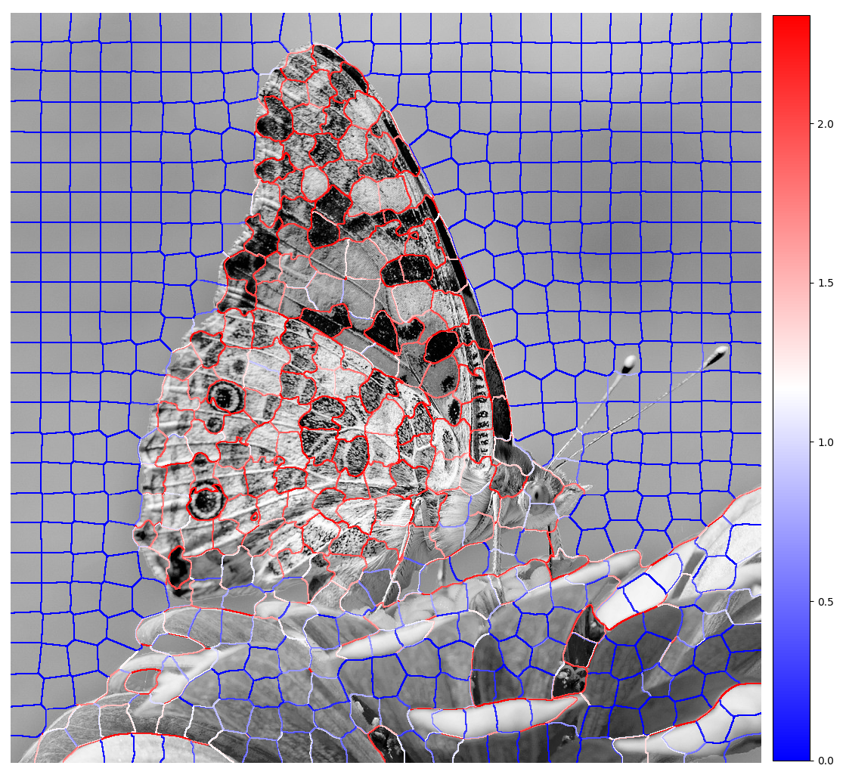

Edge Confidence
Edge Confidence
Scharr edge filter alignment edge confidence
Segmentation from edge based merging

Slide 16
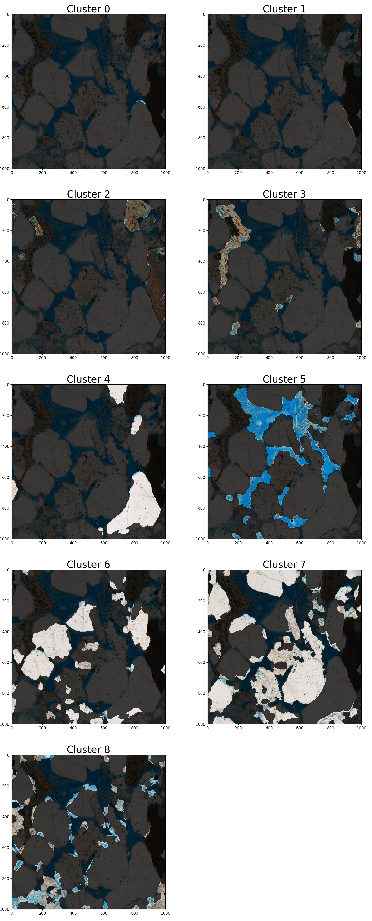
Additional: All Clusters
All clusters from Thailand image, user input labels them into the clay, rock, pore segmentation shown previously

Slide 17
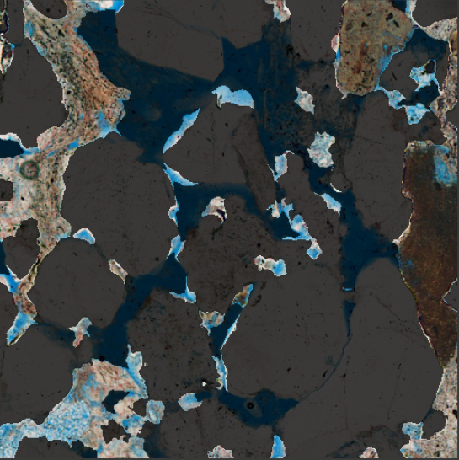
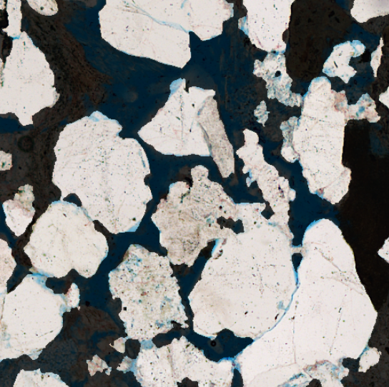
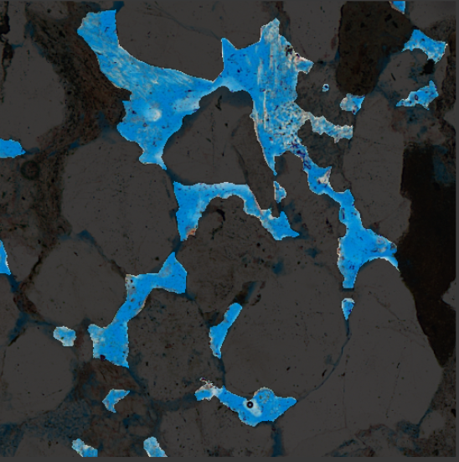
Results
Clay Regions
Rock Regions
Pore Regions
Pore too small to be segmented
Thailand sandstone
Mis-identified pore
Reasonable segmentations
However porosity results prove further work needed

Slide 18
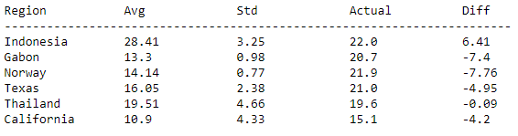
Additional: Porosity Results
Six regions sampled three times
Only sandstone considered (subset of expected images)
Possible issues: under sampling of whole image, mentioned clustering issues, need for correction factors, clustering method insufficient to capture material trends

Slide 19
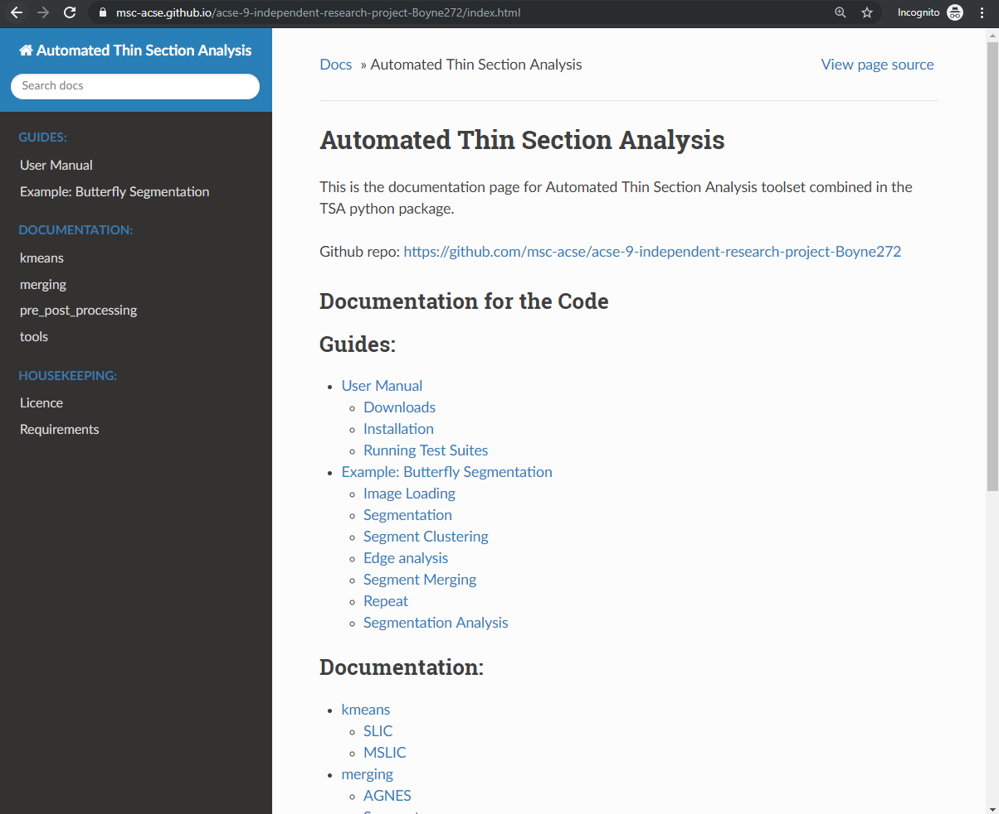
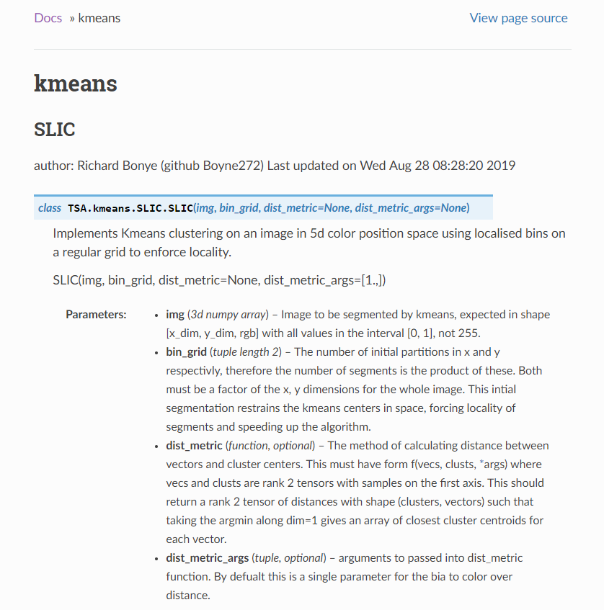
Sustainability
Reusable modular structure
Good documentation (numpy convention & sphinx)
Unit & Acceptance testing (Pytest)
Package formalisation (pip)
Linted Code (Pylint)
Frequently commented code
Hosted on GitHub Pages
https://msc-acse.github.io/acse-9-independent-research-project-Boyne272/index.html

Slide 20
Conclusions
TSA Developed
Sustainable for future development
Adaptable
SLIC distance metric
MSLIC combination metric
Clustering features and algorithm
Edge detection metrics
Usable for TS analysis pipeline development
Valid with initial segmentations looking reasonable
Further Work Needed
Clustering difficulties
Edge detection difficulties
Initial porosity results poor
Unsupervised clustering may be unable to achieve desired TS automation
Potential for user based corrections and label storing
Unconsidered features (e.g. image size)

Slide 21
Thank you
Questions

Slide 22
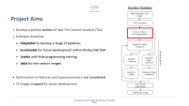

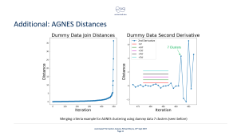
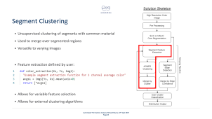
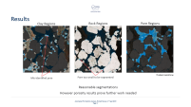

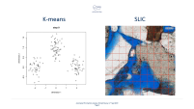
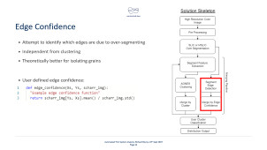
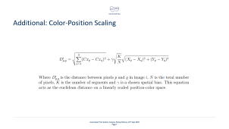
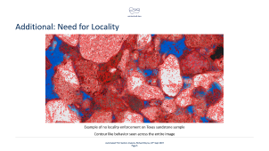
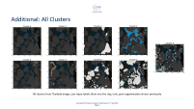


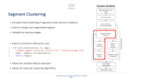

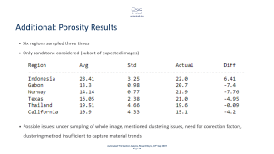

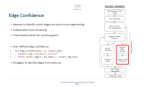

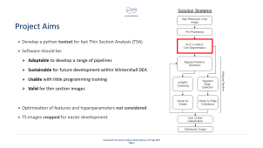
Intro
Project Aims
Over Segmentation
Clustering
Edge Detection
Results
SLIC Locality
SLIC Dist. Metric
AGNES Distances
Pre-label Clusters
Porosity Results

